Slide 1
Intro to Coding with Python– Working with Files
Dr. Ab Mosca (they/them)
Slides based off slides courtesy of Jordan Crouser (https://jcrouser.github.io/)

Slide 2
Plan for Today
What is a file
Read data in
Writing data out

Slide 3

RECAP: Computer Drive Stores Information

Slide 4
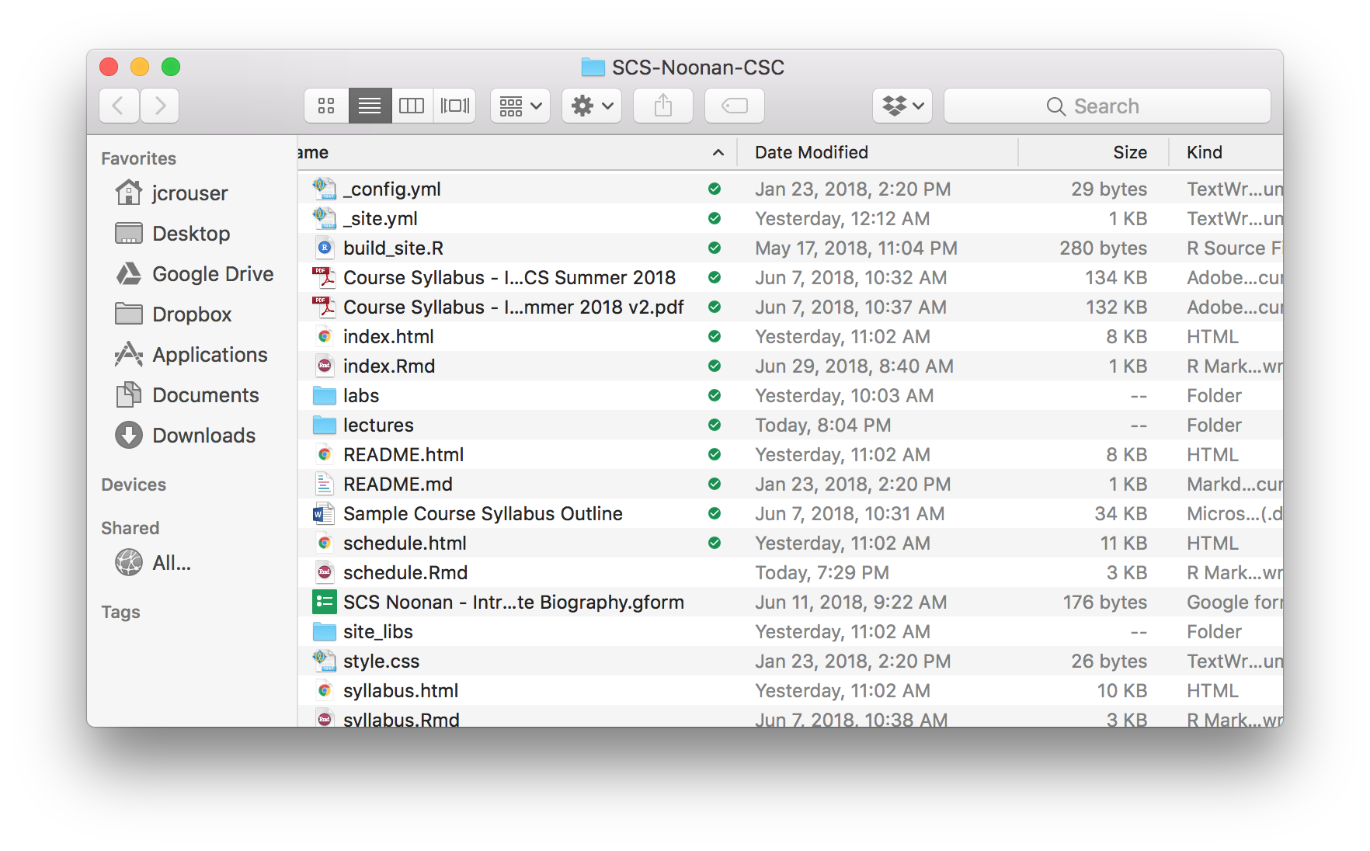
What is a file?

Slide 5
Working with files
Containers of bits, organized into bytes
Could represent text, images, music, movies, programs, applications, list of files (folders)… but underneath, they’re all the same: 0s and 1s
We’ll start by playing with text files

Slide 6
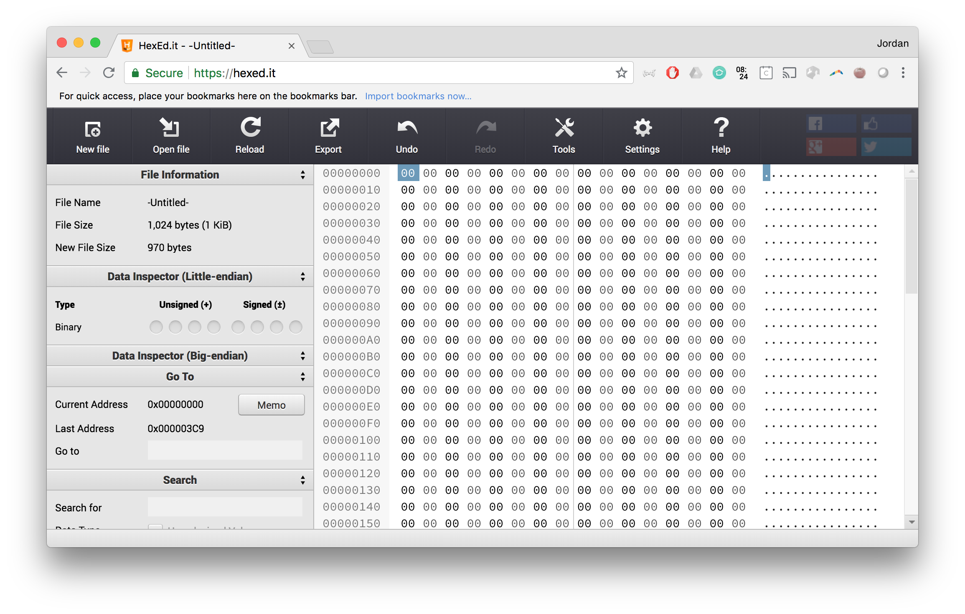
Demo: looking inside a text file
Notes:
https://hexed.it/

Slide 7
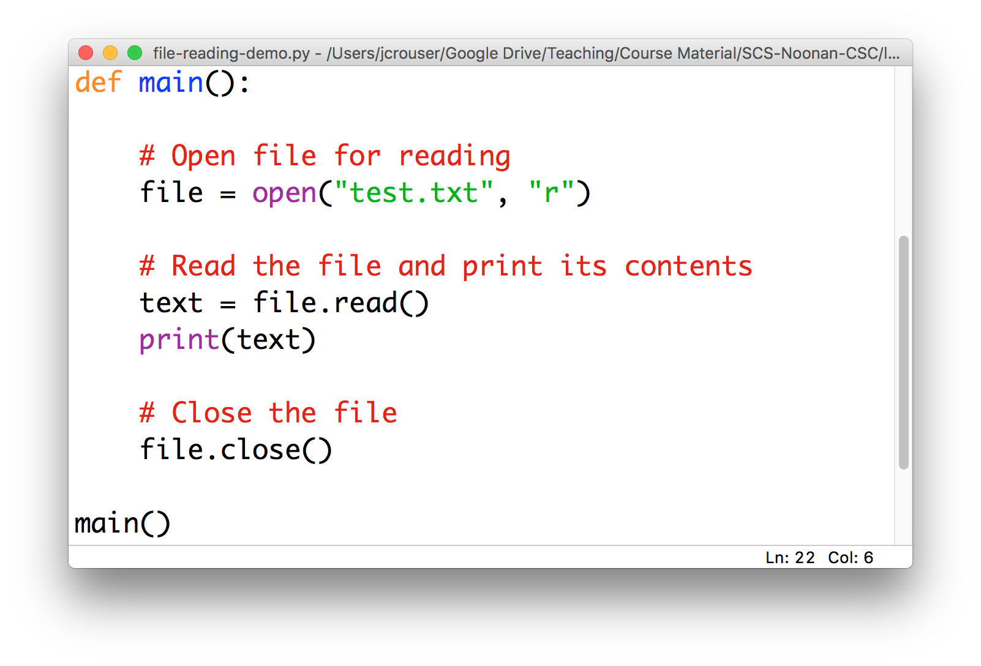
Reading a text file
In order to bring data stored in a text file into a Python program, we need to read it:

Slide 8
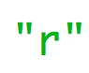
Reading a text file
In order to bring data stored in a text file into a Python program, we need to read it:
“r” stands for
READ-MODE

Slide 9

Reading a text file
In order to bring data stored in a text file into a Python program, we need to read it:
as with email or texts
opening != reading

Slide 10
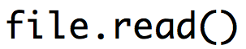
Reading a text file
In order to bring data stored in a text file into a Python program, we need to read it:
file is now an object
with a .read() method
that returns a string

Slide 11
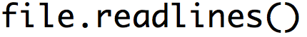
Reading a text file
In order to bring data stored in a text file into a Python program, we need to read it:
it also has a
.readlines() method
that returns a list of strings

Slide 12
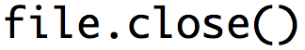
Reading a text file
In order to bring data stored in a text file into a Python program, we need to read it:
after you .read() or .readlines()
a file, remember to .close() it

Slide 13
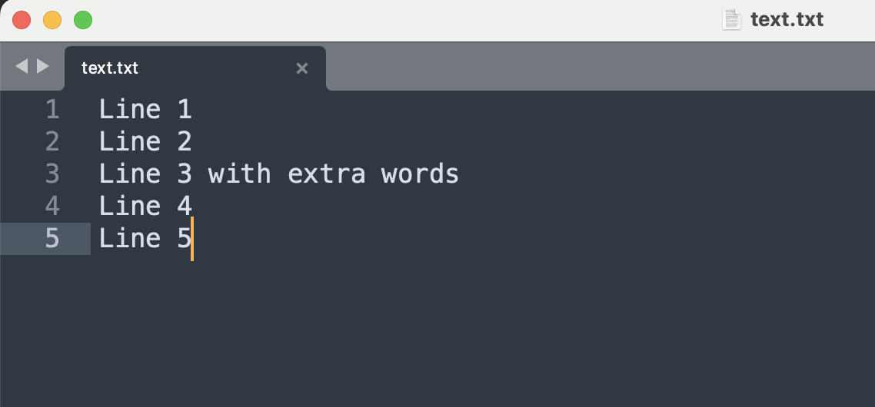
Demo: Reading a text file
Notes:
# open file for reading
file = open("text.txt", "r")
# read file and print contents
text = file.read()
print(text)
# close file
file.close()

Slide 14
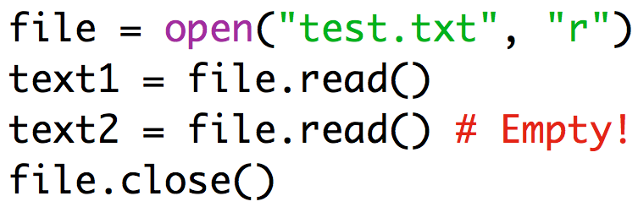
Key points for reading files
Three-step process:
.open()
.read() or .readlines()
.close()
All three steps, always in that order
If you want to .read() a file multiple times, you have to repeat the whole process

Slide 15
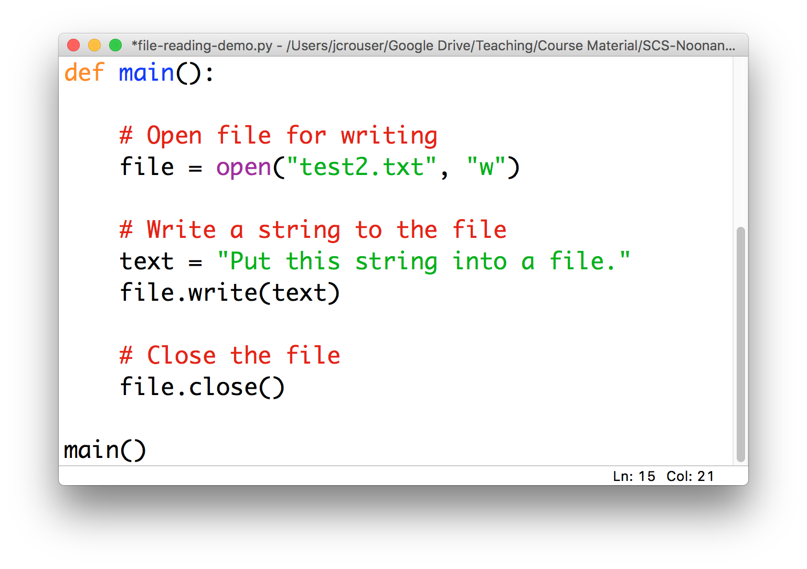
Writing data to a text file
The process looks very similar when we want to write data to a file:

Slide 16

Writing data to a text file
The process looks very similar when we want to write data to a file:
exactly the same function
to .open() a file

Slide 17
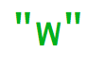
Writing data to a text file
The process looks very similar when we want to write data to a file:
“w” stands for
WRITE-MODE

Slide 18
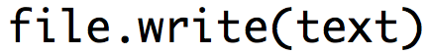
Writing data to a text file
The process looks very similar when we want to write data to a file:
file is now an object
with a .write() method
that takes in a string

Slide 19
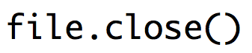
Writing data to a text file
The process looks very similar when we want to write data to a file:
as before, after you .write() to a file
remember to .close() it

Slide 20
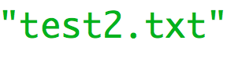
Writing data to a text file
Some quirks to be aware of when writing to files:
if this file doesn’t exist
Python will create it

Slide 21
Writing data to a text file
Some quirks to be aware of when writing to files:
if this file does exist
Python will overwrite it

Slide 22
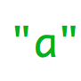
Writing data to a text file
Some quirks to be aware of when writing to files:
if you want to
add to an existing file
instead of overwrite it
“a” stands for
APPEND-MODE

Slide 23
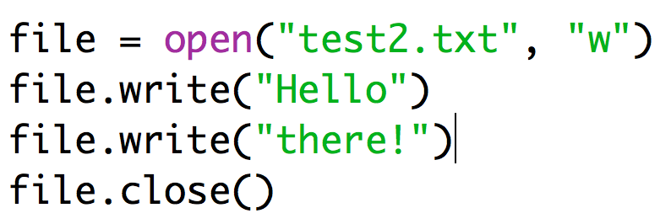
Key points for writing to files
Three-step process:
.open()
.write()
.close()
Unlike .read(), you can .write() to an .open() file as many times as you want (appending each time)
If you want a new line, you have to add it yourself! (\n)

Slide 24
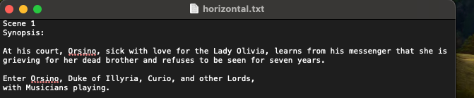
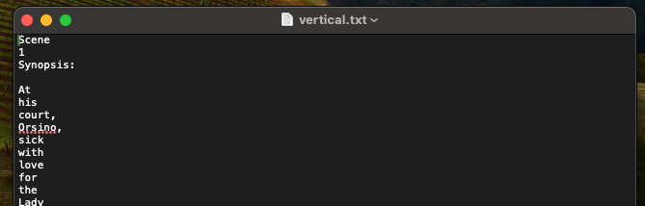
15-minute exercise: read and write
Write a program that:
reads the file horizontal.txt (under Demos on the course website; you will need to download it and save it in the same folder as your .py file)
breaks it into individual words
writes the words to a new file vertical.txt, each one on its own line

Slide 25
Discussion
What did you come up with?

